Slide 1
LightGBM
LightGBM (Light Gradient Boosting Machine) is a machine learning algorithm used for regression (predicting numbers) and classification (predicting categories).
It builds many small decision trees, where each new tree learns from the mistakes (errors) of the previous trees.

Slide 2
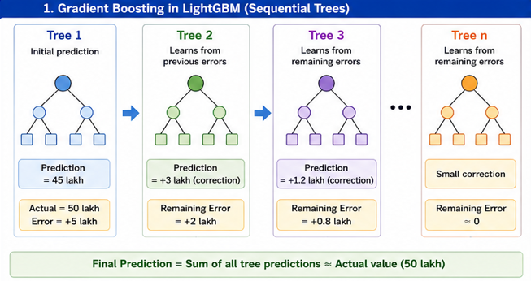
SEQUENTIAL TREE

Slide 3
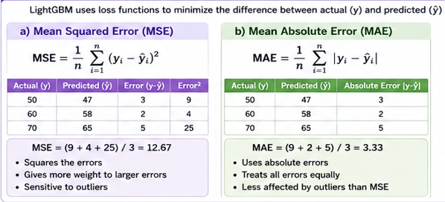
LOSS FUNCTION

Slide 4
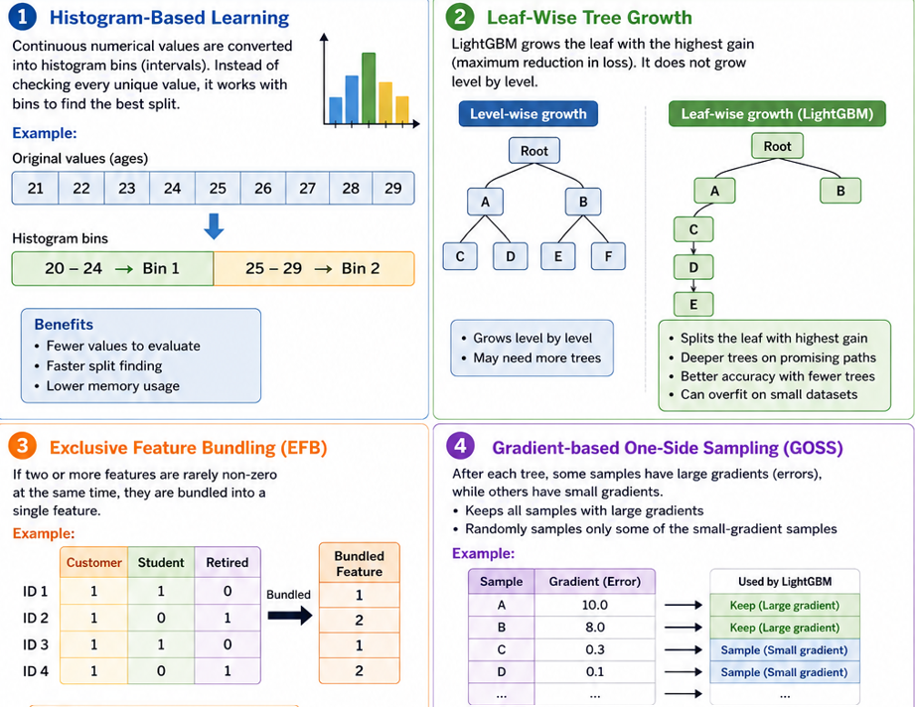
FEATURES

Slide 5
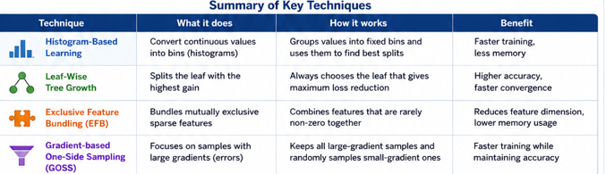
SUMMARY

Slide 6
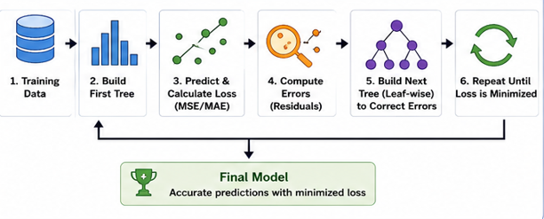
WORKFLOW

